Slide 1
Lecture 13

Slide 2
Stream Ciphers

Slide 3
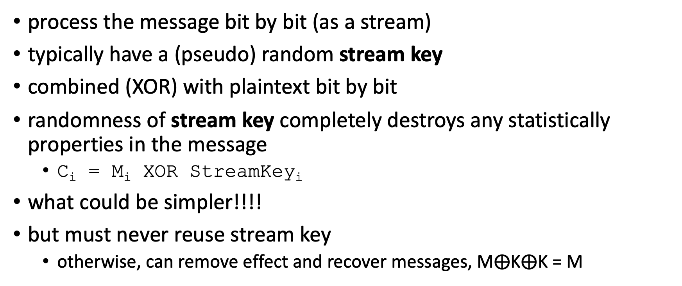
Stream Ciphers
process the message bit by bit (as a stream)
typically have a (pseudo) random stream key
combined (XOR) with plaintext bit by bit
randomness of stream key completely destroys any statistically properties in the message
C_{i} = M_{i} XOR StreamKey_{i}
what could be simpler!!!!
but must never reuse stream key
otherwise, can remove effect and recover messages, M$⨁$K$⨁$K = M

Slide 4
Stream Cipher Properties
some design considerations are:
statistically random
depends on large enough key
large linear complexity
correlation immunity
confusion
diffusion

Slide 5
How to generate Stream Key?
How to generate Stream Key?

Slide 6
Stream Ciphers
Idea: replace “rand” by “pseudo rand”
Use Pseudo Random Number Generator
A secure PRNG produces output that looks indistinguishable from random
An attacker who can’t see the internal PRNG state can’t learn any output
PRNG: {0,1}^{s} → {0,1}^{n}
expand a short (e.g., 128-bit) random seed into a long (typically unbounded) string that “looks random”
Secret key is the seed
Basic encryption method: E_{key}[M] = M ⊕ PRNG(key)

Slide 7


Stream Ciphers
Protocol: Alice and Bob both seed a secure PRNG with their symmetric secret key, and then use the output as the key for stream key
Alice
Bob
Seed(k)
Seed(k)
Generate(n)
Generate(n)
Plaintext
$$⊕$$
Ciphertext
$$⊕$$
Plaintext

Slide 8


Stream Ciphers: Encrypting Multiple Messages
How do we encrypt multiple messages without key reuses?
Alice
Bob
Seed(k)
Seed(k)
Generate(n)
Generate(n)
Plaintext
$$⊕$$
Ciphertext
$$⊕$$
Plaintext

Slide 9
Stream Ciphers: Encrypting Multiple Messages
Solution: For each message, seed the PRNG with the key and a random IV, concatenated(“|”). Send the IV with the ciphertext
Alice
Bob
IV
IV
Seed(k | IV)
Seed(k | IV)
Generate(n)
Generate(n)
Plaintext
$$⊕$$
Ciphertext
$$⊕$$
Plaintext

Slide 10
Real-world example: RC4
a proprietary cipher designed in 1987
Extremely simple but effective!
Very fast - especially in software
Easily adapts to any key length, byte-oriented stream cipher
widely used (web SSL/TLS, wireless WEP, WAP)
A trade secret by RSA Security
uses that permutation to scramble input info processed a byte at a time

Slide 11

RC4 Stream Cipher
key
(seed)
key stream
(pseudo random sequence)
RC4 (K|IV)
K
011010010111
$$⊕$$
C
ciphertext
M
message

Slide 12
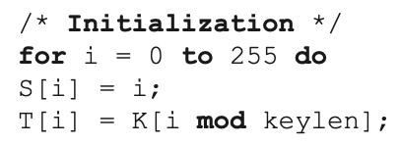
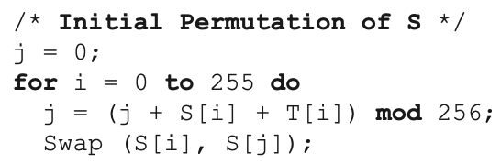
RC4 Key Schedule
starts with an array S of numbers: 0…255
use key to well and truly shuffle
S forms internal state of the cipher
given a key k of length I bytes
Throw away T & K, retain S

Slide 13
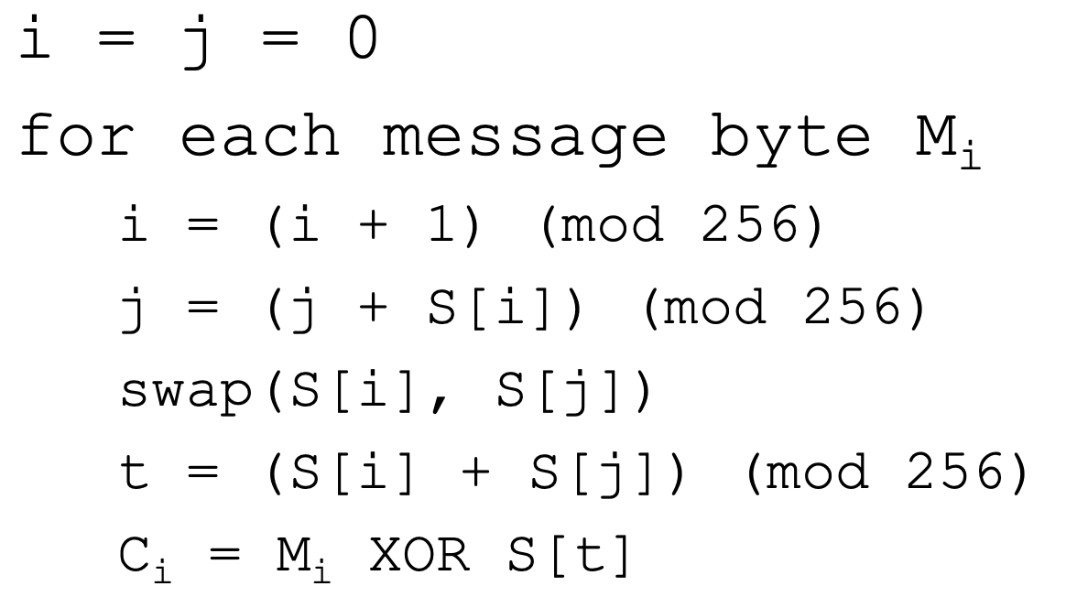
RC4 Encryption
encryption continues shuffling array values
sum of shuffled pair selects "stream key" value
XOR with next byte of message to en/decrypt

Slide 14
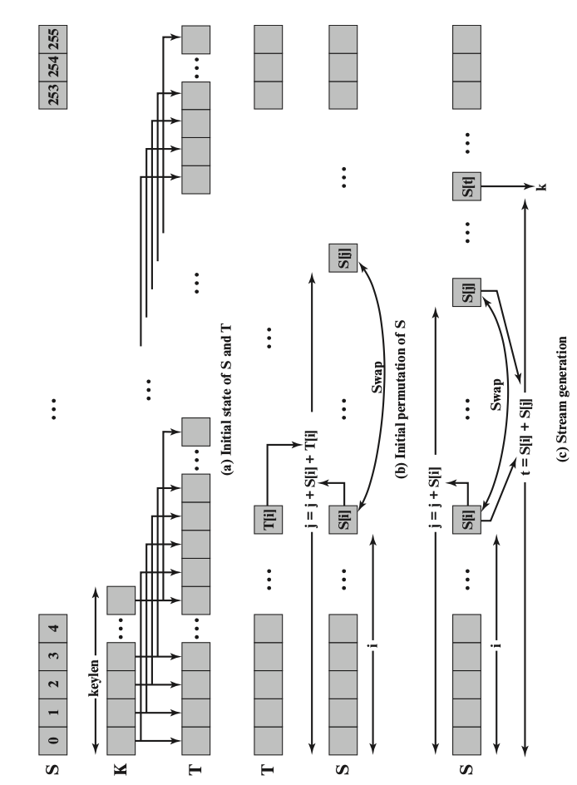
RC4

Slide 15
RC4 Security
claimed secure against known attacks
since RC4 is a stream cipher, must never reuse a key
have a concern with WEP, but due to key handling rather than RC4 itself
RC4 is widely used, in SSL for secure web transactions amongst other uses. Currently it’s regarded as quite secure, if used correctly.
Extensively studied, not a completely secure PRNG, first part of output biased, when used as stream cipher, should use RC4-Drop[n]
Which drops first n bytes before using the output
Conservatively, set n=3072

Slide 16
Summary – Chapter 2
Symmetric block cipher
DES, 3DES
AES
Random number
true random number
pseudorandom number
Stream cipher
The security of symmetric encryption depends on the secrecy of the key
Symmetric encryption: pros and cons

Slide 17
Reading material
Encryption: Strengths and Weaknesses of Public-key Cryptography

Slide 18
Homework 1 - individual
For Chapter 1 & 2
Deadline: Feb. 24 (Friday), 11:59 pm

